Slide 1
Input/Output

Slide 2
Outline
I/O Basics
Asynchronous vs. Synchronous
Memory Mapped I/O vs. Special I/O Instrs.
Interrupt Driven cs. Polling
LC-3 Implementation of Memory Mapped I/O
Keyboard Input
Monitor Output
Full Implementation on LC-3

Slide 3

Synchronicity
Asynchronous
Electronic, mechanical and human speed
Speed mismatch
Handshaking: Ready bit
Synchronous
Processor operation
Certain kinds of high speed I/O

Slide 4
Transfer Timing
I/O events generally happen much more slowly than CPU cycles.
Synchronous
data supplied at a fixed, predictable rate
CPU reads/writes every X cycles
Asynchronous
data rate less predictable
CPU must synchronize with device, so that it doesn’t miss data or write too quickly

Slide 5
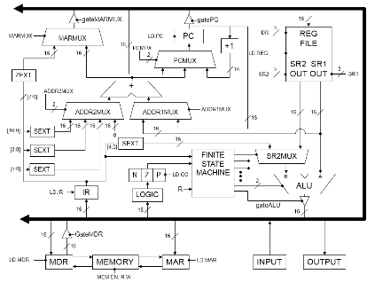
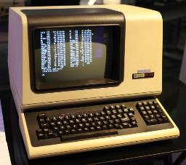

How do we do I/O?

Slide 6
How we do I/O

Slide 7
Two Methods of Doing I/O
Special I/O instructions
Need an opcode
Need to be general enough to work with devices that haven’t been invented yet
Memory-mapped I/O
Steal part of the address space for device registers
Operations done by reading/writing bits in the device registers
(We’re going to concentrate on this method)

Slide 8
Device Registers
Data registers: Used for the actual transfer of data i.e. character code
Status registers: Information the device is telling us
Control registers: Allows us to set changeable device characteristics
Device registers are often part of the i/o device itself

Slide 9
Device Registers
Options
May be memory mapped. That is the device register has a memory address
May have special I/O instructions

Slide 10
Memory Mapped vs. Special I/O Instructions
If device registers are located at valid memory addresses, how can we access them?
How can they be located at valid memory addresses?
"The very old PDP-8 (from DEC, light years ago—1965) is an example of a computer that used special I/O instructions."

Slide 11
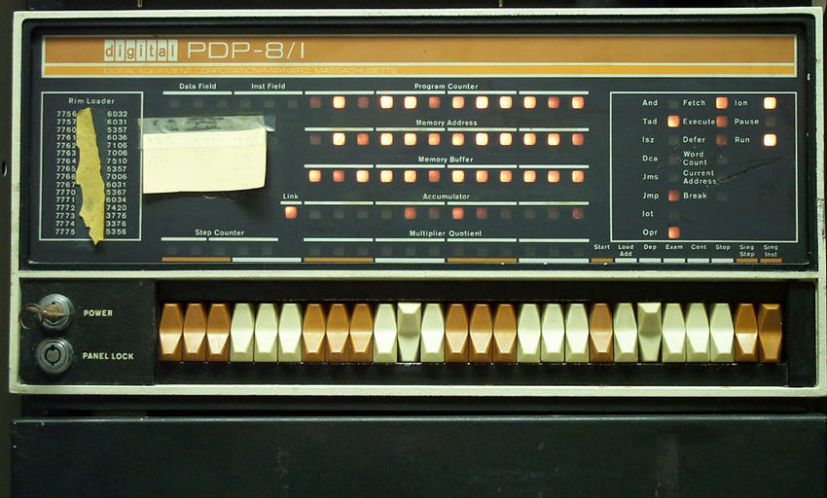

Slide 12
Interrupt-Driven vs. Polling
Two ways to handle I/O completion
Interrupt-driven
Excuse me but I've just given you a character
Polling
Has a character been typed?
Has a character been typed?
Has a character been typed?
Has a character been typed?
Has a character been typed?
Has a character been typed?
(We’ll start with this approach)

Slide 13

Family Vacation!
Dad, Dad, are we there yet?
Not yet.
Dad, Dad, are we there yet?
Not yet.
Dad, Dad, are we there yet?
Not yet. (sigh)
……….
This is polling, right?
So what would the interrupt script sound like?
Dad, Dad, are we there yet?
No. Put your heads back, take a nap and I’ll wake you when we get there.
(long silence)
OK kids, wake up! We’re here!

Slide 14
Our First Attempts at I/O
We’ll be working with asynchronous I/O instead of synchronous
We’re going to use memory mapped I/O instead of special I/O instructions
We’re going to use polling instead of interrupts

Slide 15
LC-3 Address Space
x0000
xFDFF
Device registers
How many?
xFE00 = 1111 1110 0000 0000
xFFFF

Slide 16
Keyboard Input
KBSR (xFE00)
Only uses 1 bit. Why bit 15 instead of 0?
Bit 15 is set when a character is available
KBDR (xFE02)
Really only need 8 bits but 16 easier
This location is read-only
Reading clears KBSR
(There’s also an Interrupt Enable bit not shown in KBSR to indicate we want to be interrupted when KBSR[15] is set to 1, but we’re going to wait to discuss that)
rdy
data

Slide 17
Memory Mapped Input
Gate
MDR
16
Can you build a circuit that does this?
If MAR == 0xFE00
INMUX=1
else if MAR == 0xFE02 INMUX=2
else
INMUX=0
MDR
LD.MDR
MAR
LD.MAR
R.W/READ
INPUT
16
ADDRESS
CONTROL
LOGIC
MEMORY
KBSR
KBDR
16
2
2
MEM.EN,
R.W
INMUX

Slide 18
; Read characters from the keyboard until CTRL/Z
.orig x3000
ld r4, term
lea r2, buffer ; Initialize buffer pointer
start ldi r1, kbsrA ; See if a char is there
BRzp start
ldi r0, kbdrA ; get the character
str r0, r2, 0 ; Store it in buffer
not r0, r0 ; subtract R4-R0
add r0, r0, #1 ; to check for termination
add r0, r0, r4 ; char stored in R4
brZ quit
add r2, r2, 1 ; Increment buffer pointer
br start ; Do it again!
quit halt
term .fill x001A ; CTRL/Z
kbsrA .fill xfe00
kbdrA .fill xfe02
buffer .blkw x0100
.end

Slide 19
Monitor Output
DSR (xFE04)
Transferring a character to DDR clears DSR
When monitor is finished processing a character it sets DSR bit 15
"Please sir, may I have another?”
DDR (xFE06)
Transfer character to this address to print it on the monitor
(There’s also an Interrupt Enable bit not shown in DSR to indicate we want to be interrupted when DSR[15] is set to 1, but we’re going to wait to discuss that)
rdy
data

Slide 20
; Write the contents of a string to the display
.orig x3000
lea r2, buffer ; Initialize buffer ptr
start ldr r0, r2, 0 ; Get char into r0
brZ quit ; Terminate on null
wait ldi r3, dsrA ; Are we ready?
brZP wait
sti r0, ddrA ; Send R0 to monitor
add r2, r2, 1 ; Move buffer ptr over 1
br start
quit halt
dsrA .fill xfe04
ddrA .fill xfe06
buffer .stringz "Hello, World!"
.end

Slide 21
Loading a value from the Keyboard Data Register (KBDR) into a CPU register causes the following to happen:
The RDY bit in the KBSR is cleared
A byte is moved from KBDR to the designated CPU register
A and B
None of the above
Today's number is 98,065
10

Slide 22
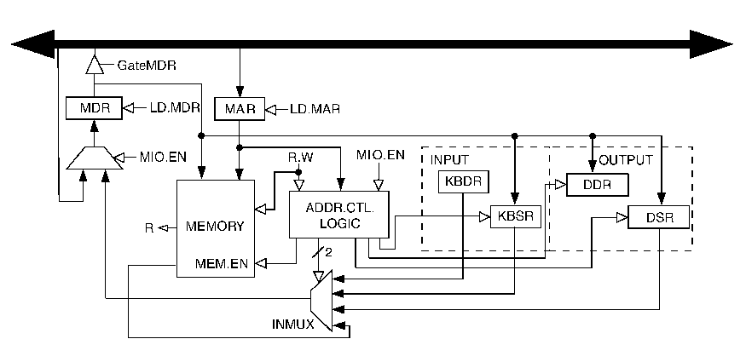
Full Implementation of LC-3 Memory-Mapped I/O
Because of interrupt enable bits, status registers (KBSR/DSR) must be written, as well as read.

Slide 23
Questions?
I/O Basics
Asynchronous vs. Synchronous
Memory Mapped I/O vs. Special I/O Instrs.
Interrupt Driven cs. Polling
LC-3 Implementation of Memory Mapped I/O
Keyboard Input
Monitor Output
Full Implementation on LC-3

